Slide 1
Software Engineering
Lesson – System Modelling through UML

Slide 2
Lesson Content
What is a model?
Different Models/Software Views
Object Oriented Modelling
Unified Modelling Language UML
Fitting UML into a process

Slide 3
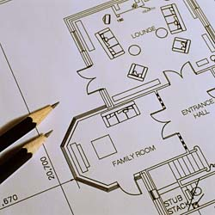
Design and Modeling
Model-driven design emphasizes the drawing of pictorial system models to document and validate both existing and/or proposed systems.
Just as “a picture is worth a thousand words,” most models use pictures to represent the reality or vision.
Interior Design Plan
Architectural Plan
Wiring Diagram

Slide 4

Why to use Modeling?
Enhance Communication
People usually want to communicate in the simplest form possible. The same thing with software developers
Visual Communication is also important from a management or user perspective. They don’t understand code.
Solve communication difficulties common for current IT Business trends:
Aggregation of smaller companies into larger ones
Overseas IT outsourcing
As a result of improved communication:
Reduce Risks
Save Time
Improve Design Quality

Slide 5
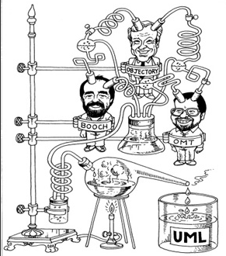
What is UML
Unified Modeling Language - standard language for specifying, visualizing, constructing and documenting all the artifacts of the software system.
History:
Many different methodologies with different notations
Synthesis of several notations:
Grady Booch (Rational Inc)
James Rumbaugh (OMT – Object Modeling Technique)
Ivar Jackobson (OOSE – Object Oriented Software Engineering)
Standardized by OMG in 1997

Slide 6
Why to Use UML?
Provides a standardized set of tools to document the analysis and design of a software system
Allow people to visualize the construction of an OO system, similar to the way blueprints allows people to visualize the construction of a building
Provides means of communication between the development team and business persons of the project.

Slide 7
Ways of using UML
Sketching
The most common way, informal, quick and collaborative
Using whiteboard
To help developers communicate some aspects of the system[2]
Blueprinting
Like engineers handing over their blueprints to construction companies to build
Using CASE tools
Complete system design is produced and should be followed by a programmer
Programming
If all the system can be specified in UML, it becomes a programming language
Compiled directly to executable code

Slide 8
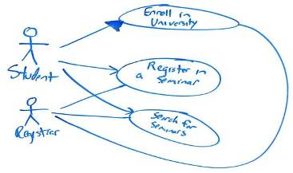
UML as a sketch
The essence of sketching is selectivity[2].
Forward engineering - You use sketched to rough out some issues in the code you are about to write.
Reverse engineering – You use sketches to explain how some part of a system works.
Sketches are intentionally incomplete
Only important issues, ideas and alternative solutions that you want to discuss before you start coding are sketched

Slide 9
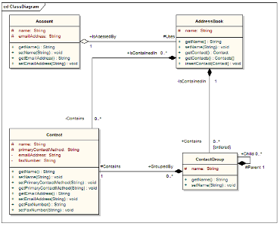
UML as a blueprint
A blueprint is focused on completeness.
Forward engineering – designer/system architect builds a detailed and sufficiently complete design for a programmer to code with little thought
Reverse Engineering – you use a blueprint to show every detail of a system in a graphical form that is easier to understand
Blueprints are comprehensive with the aim of reducing programming to a simple and fairly mechanical activity[2].

Slide 10
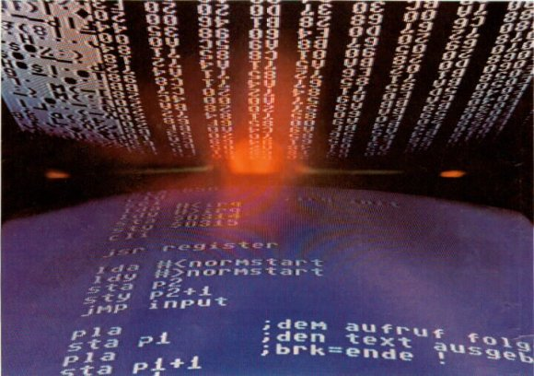
UML as a programming language
For UML to be considered as a programming language, developers draw UML diagrams that are compiled directly to executable code.
If UML is the source code, therefore the concepts of forward/reverse engineering do not apply any more.

Slide 11
Three primary aspects of a system
Data, objects or concepts and their structure;
Business processes (Use Cases);
Dynamics or system behavior.

Slide 12
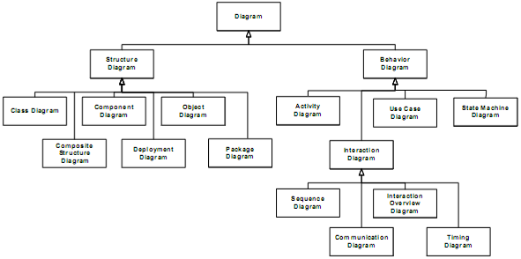
UML Diagrams

Slide 13
13 UML Diagrams
Diagram | Purpose
Use Case | Used to model user/system interactions. They define behaviour, requirements and constraints
Class | Displays basic building blocks of a model: the classes and relationships between them
Sequence | Show the sequence of messages passed between objects using a vertical timeline
State Chart | How events change an object’s state throughout its life cycle
Activity | Shows basic program flow, captures the decision points and actions within the process.
http://www.sparxsystems.com/resources/uml2_tutorial/

Slide 14
13 UML Diagrams
Diagram | Purpose
Communication (ex-collaboration) | Interaction between objects: emphasis on links
Component | Structure & connections of components
Composite Structure (new) | Runtime decomposition of a class

Slide 15
13 UML Diagrams
Diagram | Purpose
Deployment | Deployment of artifacts to nodes
Interaction overview (new) | Mix of sequence & activity diagram
Object | Example configurations of instances
Package | Compile time hierarchic structure
Timing (new) | Interaction between objects: emphasis on timing

Slide 16
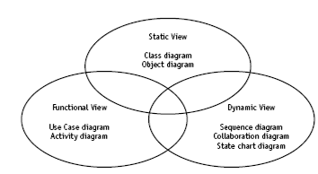
UML
Defines a set of diagramming techniques representing
Static, Dynamic and Functional View
The key building block is a use case
Diagrams are tightly integrated syntactically and conceptually to represent an integrated whole
Application of UML can vary among organizations

Slide 17
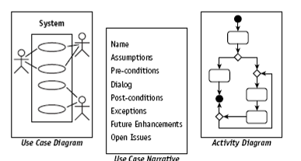
Functional View
Includes
The Use Case diagram which describes the features that the users expect the system to provide.
The Activity diagram describes processes including sequential tasks, conditional logic, and concurrency. This diagram is like a flowchart, but it has been enhanced for use with object modeling.

Slide 18
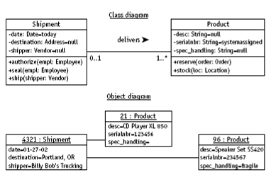
Static View
The Class diagram is the primary static diagram. It is the foundation for modeling the rules about types of objects (classes), the source for code generation, and the target for reverse engineering.
The Object diagram illustrates facts in the form of objects to model examples and test data. The Object diagram can be used to test or simply to understand a Class diagram.
Static View was like a blueprint. In the blueprint you can see elements of the structure, but not how they work together

Slide 19
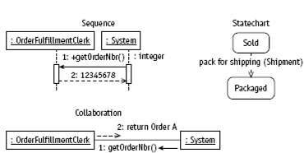
Dynamic View
For modeling object interactions, the Dynamic View includes the Sequence and Collaboration diagrams.
The State transition diagram provides a look at how an object reacts to external stimuli and manages internal changes.

Slide 20
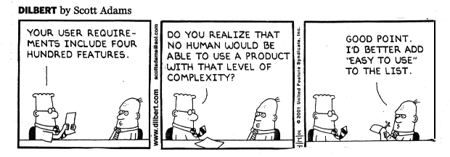
Fitting the UML into a Process: 1Requirements Analysis
“The activity of requirements analysis involves trying to figure out what the users and customers of a software effort want the system to do” [2, p. 29]
The most important thing when gathering requirements, is understanding your users/customers.
Use non-technical language, avoid complex UML notation
Interviews, Meetings, Reading existing documentation would help

Slide 21
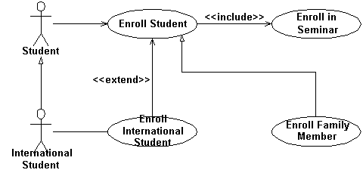
Fitting the UML into a Process: 1Requirements Analysis
Applicable UML techniques[2]:
Use Cases – describe how people interact with the system
Activity Diagram – show how software and human activities interact (business process)
Class diagram – used from a conceptual perspective can be a good way of building up a rigorous vocabulary of the domain
State Diagram – useful if an object has an interesting lifecycle, with various states

Slide 22
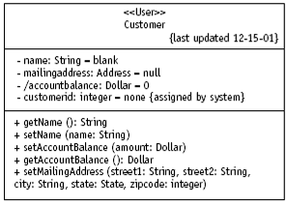
Fitting the UML into a Process: 2Design
The design stage focuses on how to deliver what the users and customers want.
Get into technical details, more notation
Design several alternatives
Applicable UML techniques[2]:
Class diagrams – show the classes in the software as well as their interrelations
Sequence Diagrams – use to figure out what happens in the most important scenarios (use cases)
Package Diagrams – show the large scale organisation of the software
State Diagrams – use to explain classes with complex life histories
Deployment diagrams – show the physical layout of the software

Slide 23
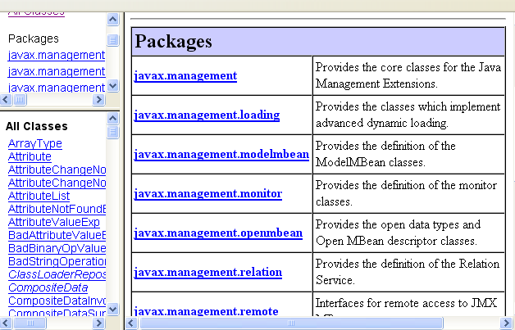
Fitting the UML into a Process: 3Documentation
UML can be a useful addition to written documents.
Detailed documentation can be generated from the code itself (JavaDoc)[2]
UML diagrams can help to make these textual documents more visual.
Document design alternatives which were NOT chosen and WHY

Slide 24
Reference List
[1] Blackwell, T, 2006, Software engineering, algorithm design and analysis: volume 1, p 3, Goldsmiths College, University of London
[2] Fowler M, 2003, UML Distilled. A Brief Guide to Standard Object Modelling Language, Addison Wesley, 3rd edition

Slide 25

End of Lesson
Any questions?

